Slide 1
JPAS Updates
Steven Burke
Industrial Security Supervisor
Lockheed Martin

Slide 2
Contents
General JPAS Updates
DMDC Contact Center Trends
Click To Sign
OPM Cyber Intrusion
Information Resources

Slide 3
JPAS Updates
Industry Persons added to Person Data Repository (PDR)
As of 28 May, ~500,000 Industry ONLY subjects in JPAS have been added to the DoD PDR
DoD ID number is now associated with each subject
Facilitates SIPRnet token issuance for this population
JPAS PII needs to be updated in the PDR and flowed to the JPAS record
See the JPAS Data Correction Checklist on the JPAS website
ISFD and JPAS interface updated on 1 June
KMP categories added/modified through ISFD JPAS interface
Interface runs nightly

Slide 4
JPAS Updates Cont.
Updated JPAS General FAQ
Provides new data on Administrative Reviews and associated processes conducted for alleged JPAS system misuses
JPAS PKI Updates
Servers will be able to communicate at TLS1.2 starting 19 June
Should reduce some user logon issues, especially with older browser versions (IE9 and below)
Data Quality Initiatives
PSMO-I & JPAS Team continues to run DQI to clean data in JPAS
Prep for JVS data migration

Slide 5
JPAS Updates Cont.
JPAS as an Authoritative System of Record
Please remember that Test or Fake SSNs cannot be used in JPAS
Only full LEGAL names and valid PII should be stored in JPAS
Updates to SMO POC Information
Eliminate extra text in contact information
Periodic Reinvestigation Submission Timeframe
Effective May 6, 2015 the Defense Security Service (DSS), Personnel Security Management Office for Industry (PSMO-I) will accept requests for periodic reinvestigations that are within 180 days of the investigation anniversary date. This is a change from the current 90 day timeframe and reinstates the previous 180 day submission window.

Slide 6
Contact Center Trends

Slide 7
DMDC Contact Center Trends
1
2
3
4
JPAS Investigation Status / Assistance
JPAS
Record Maintenance
e-QIP Authentication Reset
JPAS Account Setup
Adding a category
Indoctrinating non SCI / SCI
Separating a category
Visit requests
DQI
Investigation status
Is an investigation in scope?
Help initiating an investigation
Do not print signature pages
Need a new account
Request an Account Manager
Adding user accounts
Log off JPAS
Failed to answer Golden Questions
Forgot password

Slide 8
Click To Sign

Slide 9
Click To Sign
Click To Sign is a function in e-QIP that eliminates the need for a wet signature by allowing the applicant to “click and sign” their release forms.
Applicants will have the ability to opt out of click to sign
The release date for Click To Sign in JPAS is TBD

Slide 10
Click to Sign
Remain the same…
Eliminate…
User ID & password login capability (No PKI Cert required)
Filling out the SF-86
Submitting the SF-86 to FSO and PSMO-I
Printing and Signing
Scan, Mail, Fax, Upload
OPM Rejects:
Wrong date (format)
Signatures outside the line or unreadable
10

Slide 11
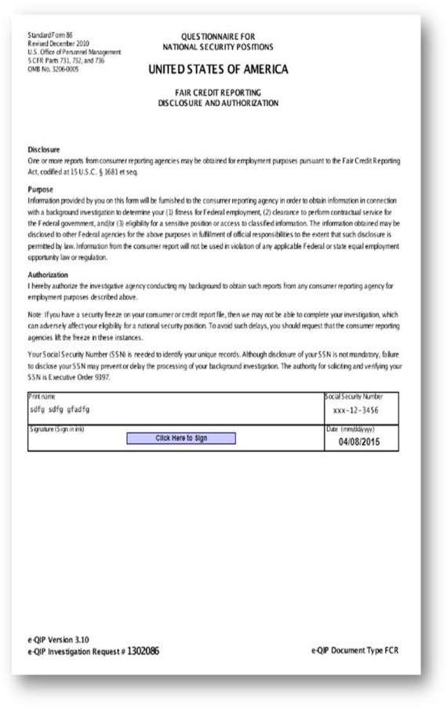
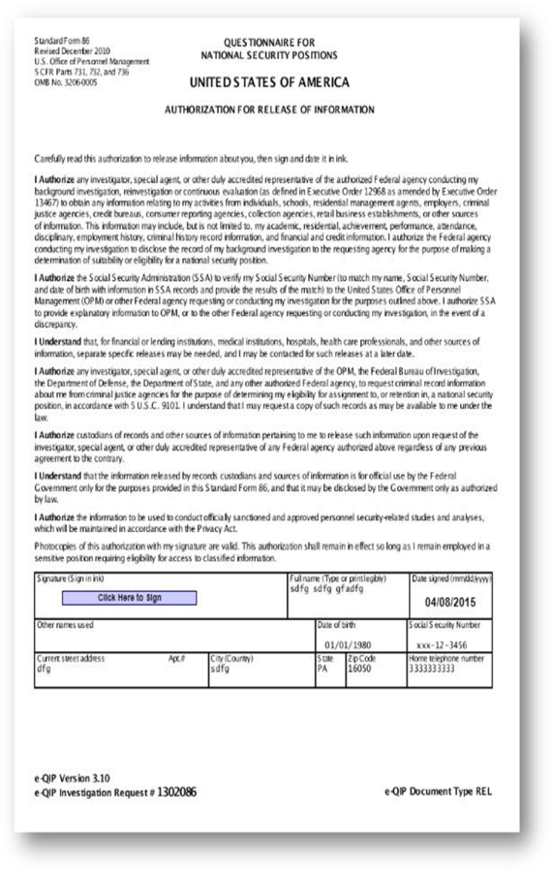
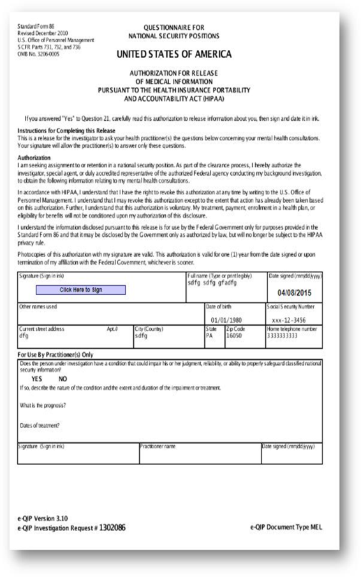
Click to Sign

Slide 12
OPM Cyber Intrusion

Slide 13
OPM Cyber Intrusion
April 2015
OPM discovered that the personnel data of 4.2 million current and former Federal government employees had been stolen. This means information such as full name, birth date, home address and Social Security Numbers were affected.
This number has not changed since it was announced by OPM in early June and you should have already received a notification if you were impacted.
June 2015
E-QIP is taken offline
OPM discovered that additional information had been compromised: including background investigation records of current, former, and prospective Federal employees and contractors.
Sensitive information, including the Social Security Numbers (SSNs) of 21.5 million individuals, was stolen from the background investigation databases.
Notifications have not been delivered as of yet
Additional Information can be found at: https://www.opm.gov/cybersecurity/

Slide 14
Manual Submission of SF86
July 13, 2015: Manual submission of SF86s from industry (based on mission critical need only)
In accordance with the memo issued by the Director of National Intelligence, “Interim Procedures during the Temporary Suspension of e-QIP” dated July 2, 2015, and Department of Defense memo, same topic, dated July 10, 2015, the Personnel Security Management Office – Industry is accepting the manual submission of the SF86 from applicants (based on mission critical need) for Initial Secret investigations only. The manual submission of the SF86 will allow PSMO-I to make an interim eligibility determination.
Once the e-QIP system is fully operational, the Facility Security Officer /Designee will be required to complete the investigation request via the e-QIP system within 14 days or notify PSMO-I if subject no longer requires interim eligibility.

Slide 15
Manual Submission of SF86 cont.
Industry Steps for Processing (Initial Secret Only):
FSO/Designee submit JPAS Research request to DoD CAF IND with the following information:
Level of Clearance requested
Reason for Request: KMP or specific contract requirement (e.g., deploy, engineer, critical support)
Agency contract supports
FSO/Designee email address and phone number
PSMO-I approves and provides instruction through JPAS message on how to submit SF86
Subject provides completed SF86 and certification page to FSO/Designee
FSO/Designee submit (encrypted) completed SF86 package to include signed certification and release pages using instructions provided in JPAS message
FSO/Designee submit fingerprints electronically to SWFT
PSMO-I review for Interim Secret eligibility and post determination in JPAS
PSMO-I store SF86 package in CATS for retention and reporting
When OPM restores the use of e-QIP, the FSO/Designee must submit an investigation request within 14 days or notify PSMO-I subject no longer requires interim eligibility.

Slide 16
Information Resources

Slide 17
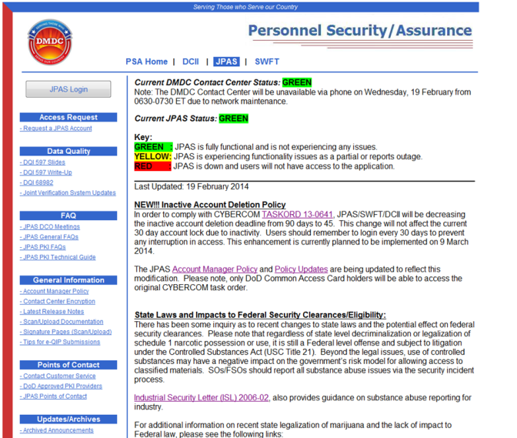
Information Resources
JPAS PSA WebPage
This is the page to bookmark: www.dmdc.osd.mil/psawebdocs
Alerts, notices, user guide resources, etc. are posted here.
DoD CAF Website
A New Site that will provide resources and FAQ’s from the DoD CAF
http://www.dodcaf.whs.mil/

Slide 18
Channels of Communication
DSS Website
DMDC PSA
VOI
JPAS Website
NCMS
DSS Webinar
Briefings to Industry
E-Mail Listserv
ISFD
CDSE Flash
JPAS SMO emails
AskPSMO-I Webinar Participants
JPAS PMO meetings
Notes:
Industry – uses Monthly meetings with Government (DMDC/DSS/NISPAC, etc.)/NCMS/Q-Tips/facebook/twitter, etc.

